Slide 1
Microbiology
Antigenic drift (leads to annual vaccination): A mechanism for variation by viruses that involves the accumulation of mutations within the antibody-binding sites so that the resulting viruses cannot be inhibited well by antibodies against previous strains making it easier for them to spread throughout a partially immune population. Antigenic drift occurs in both influenza A and influenza B viruses.
Antigenic shift (leads to pandemics): A sudden shift in the antigenicity of a virus resulting from the recombination of the genomes of two viral strains. Antigenic shift is seen only with influenza A viruses. It results usually from the replacement of the hemagglutinin (the viral attachment protein that also mediates the entry of the virus into the cell) with a novel subtype that has not been present in human influenzaviruses for a long time. The source of these new genes is the large reservoir of influenzaviruses in waterfowl. The consequences of the introduction of a new hemagglutinin into human viruses is usually a pandemic, or a worldwide epidemic.
Pathogenesis of influenza
Spread by respiratory droplets
Intubation for 1-4 days
Viral shedding starts 1 day before s/s
s/s lasts +5 days

Slide 2
Vaccination
 | Inactivated | Live-Attenuated
Formulation | Intramuscular | Intranasal
Approved Population | > 6 months Pregnant Child on chronic ASA Pulmonary disease Healthcare workers | 2-49 YO healthy, nonpregnant pts
Important Contraindications | Egg allergy worse than hives | Immunosuppression Egg allergy
Adult Dose | 1 IM injection (0.5 mL) | 1 spray/nostril (0.1 mL)
“Ingredients” (2012-13) | A/California/7/2009 (H1N1)-like A/Victoria/361/2011 (H3N2)-like B/Wisconsin/1/2010-like antigens
Notes:
low transverse cesarean section

Slide 3
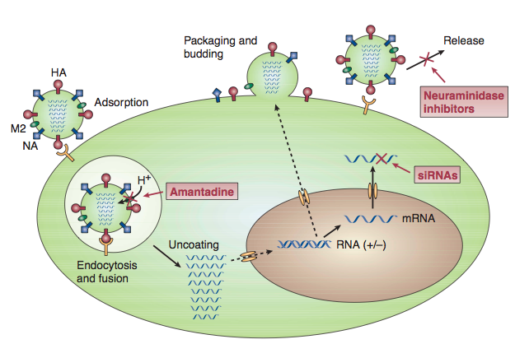
Drugs to treat Influenza
Who should it?
Children < 5 y/o
Children < 19 y/o on long term ASA
Adults > 65 y/o
Asthma, DM, renal
Pregnant
Immunosuppressed
The Drugs:
M2 Ion Channel Inhibitors
Not recommended in chemoprophylaxis b/c 100% resistance
MOA: prevent H from entering M2 ion from breaking open
Drug: Amantadine, Rimantadine
Use: Influenza A
Parkinson’s disease (amantadine)
Neuraminidase Inhibitor
MOA: prevent influenza release
Drug: Oseltamivir, Zanamivir
Use: Influenza A and B

